Slide 1


JOINS IN SQL
Sai Vardhan T

Slide 2
SQL JOIN Queries
JOIN clause is used to combine rows from two or more tables, based on a related column between them.
Types of Joins:
Inner Join
Left Join
Right Join
Self Join
Cross Join

Slide 3
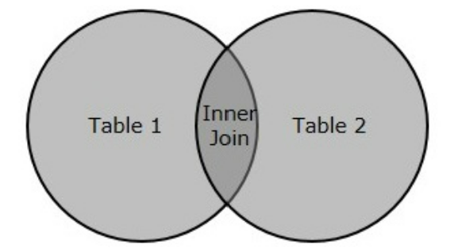
INNER JOIN
An INNER JOIN in SQL is a type of join that returns the records with matching values in both tables. This operation compares each row of the first table with each row of the second table to find all pairs of rows that satisfy the join predicate.
Few things to consider in case of INNER JOIN:
It is a default join in SQL. If you mention JOIN in your query without specifying the type, SQL considers it as an INNER JOIN.
It returns only the matching rows from both the tables.
If there is no match, the returned is an empty result.

Slide 4
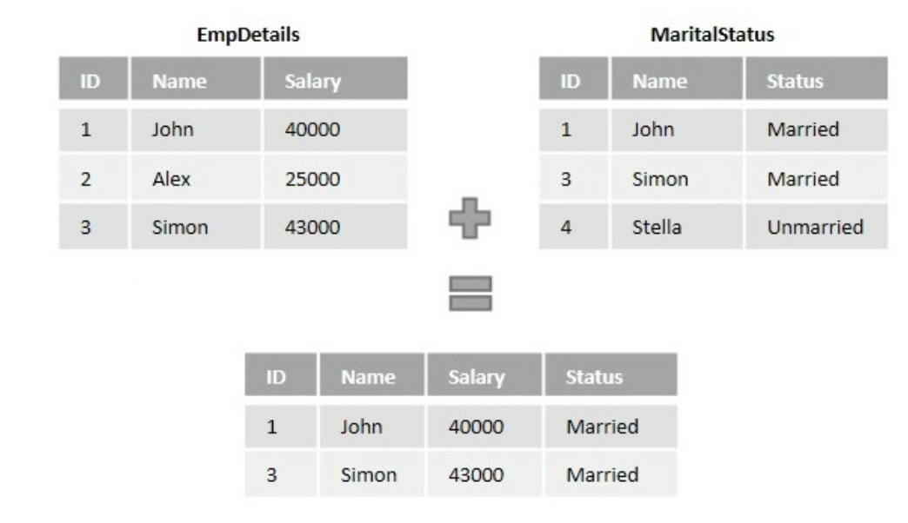
EXAMPLE

Slide 5
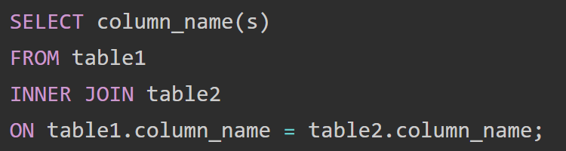
INNER JOIN
Syntax
Here is the syntax for an SQL INNER JOIN:
The INNER JOIN keyword selects records that have matching values in both tables.

Slide 6
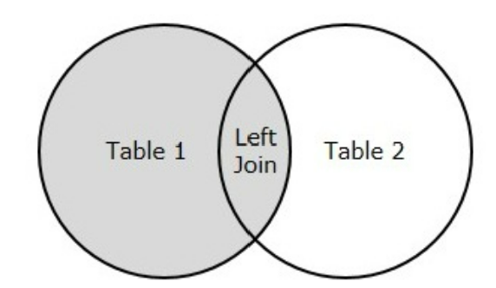
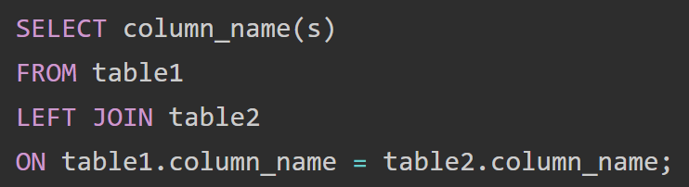
LEFT JOIN
The SQL LEFT JOIN combines rows from two or more tables based on a related column between them and returns all rows from the left table (table1) and the matched rows from the right table (table2).
If there is no match, the result is NULL on the right side.
Syntax:

Slide 7
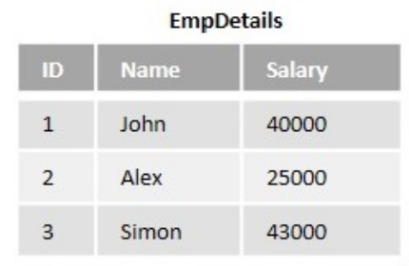
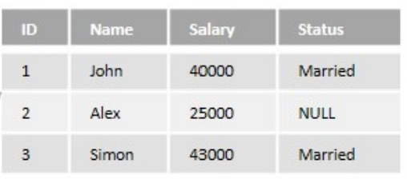
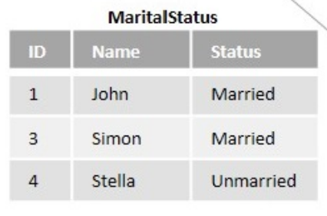
EXAMPLE

Slide 8
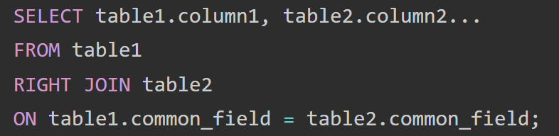
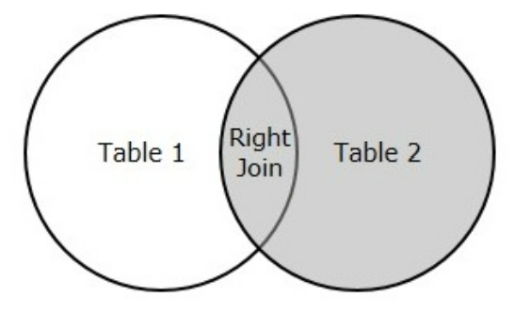
RIGHT JOIN
The RIGHT JOIN keyword returns all records from the right table (table2), and the matched records from the left table (table1).
If there is no match, the result is NULL on the left side.
Syntax:

Slide 9
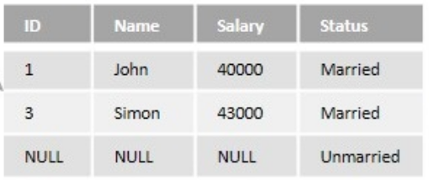
EXAMPLE

Slide 10
SELF JOIN
A SELF JOIN is a standard SQL operation where a table is joined to itself. This might sound counter-intuitive, but it’s actually quite useful in scenarios where comparison operations need to be made within a table.
Essentially, it is used to combine rows with other rows in the same table when there’s a match based on the condition provided.
It’s important to note that, since it’s a join operation on the same table, alias(es) for table(s) must be used to avoid confusion during the join operation.

Slide 11
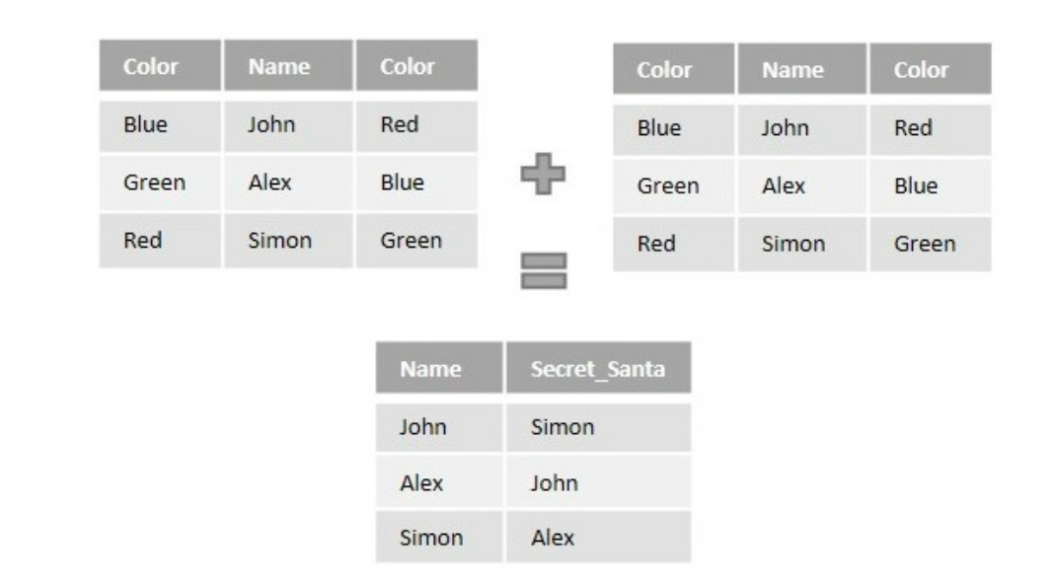
EXAMPLE

Slide 12
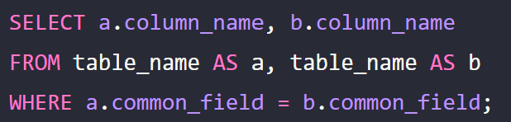
SELF JOIN
Syntax:
table_name: is the name of the table to join to itself.
a and b: are different aliases for the same table.
column_name: specify the columns that should be returned as a result of the SQL SELF JOIN statement.
WHERE a.common_field = b.common_field: is the condition for the join.

Slide 13
CROSS JOIN
The cross join in SQL is used to combine every row of the first table with every row of the second table. It’s also known as the Cartesian product of the two tables. The most important aspect of performing a cross join is that it does not require any condition to join.
The issue with cross join is it returns the Cartesian product of the two tables, which can result in large numbers of rows and heavy resource usage. It’s hence critical to use them wisely and only when necessary.

Slide 14
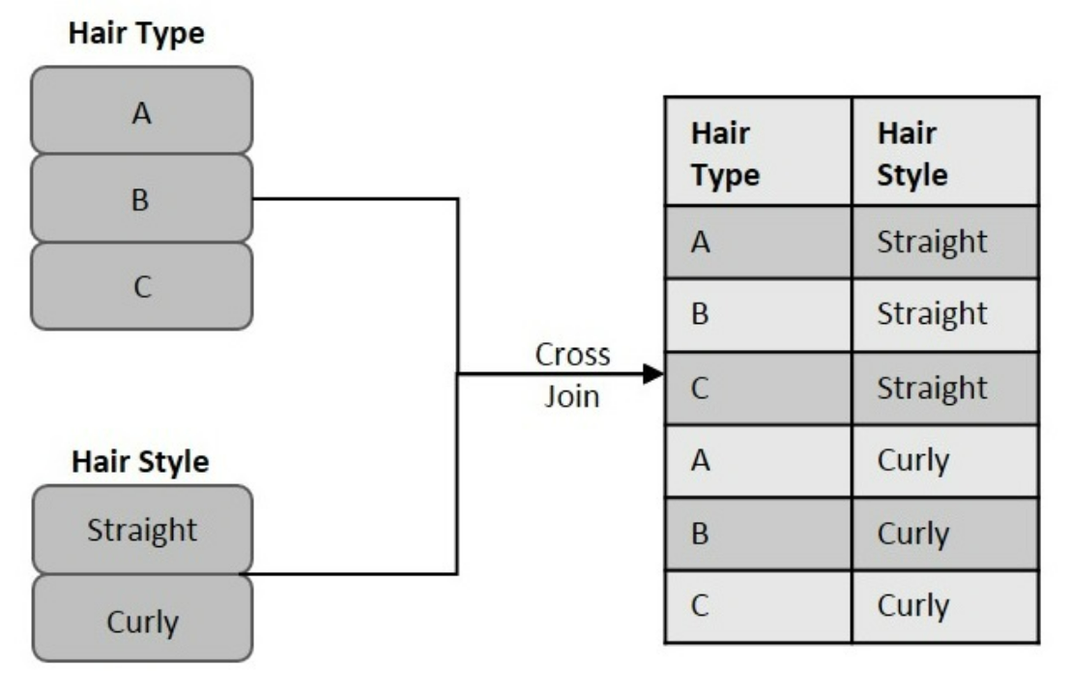
EXAMPLE

Slide 15
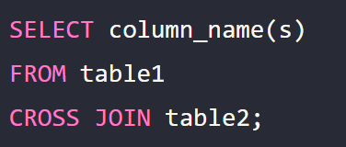
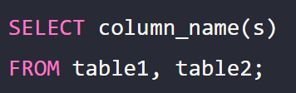
CROSS JOIN
Syntax:
Here’s the generic syntax for implementing a CROSS JOIN:
You can alternatively use the below syntax to achieve the same result:

